Slide 1
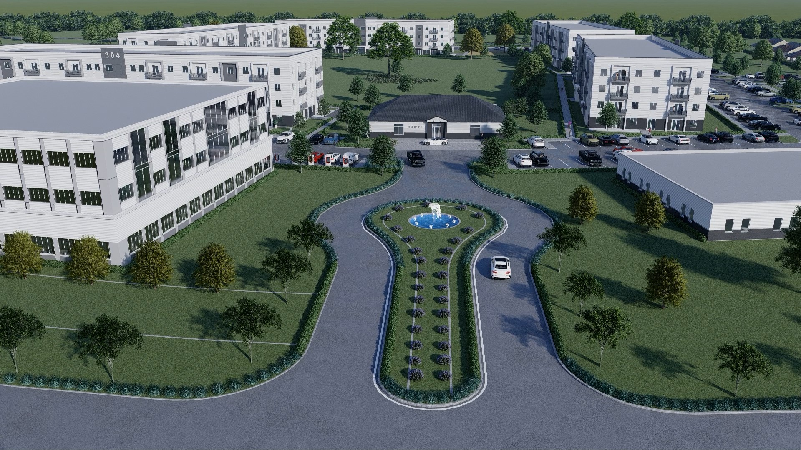
LIFESTYLE with PURPOSE
VICTORY STAR VILLAGE, Serving
Sioux Falls, SD, Tea, and Canton – Serving 250,000 citizens
Victory Star Village
Sioux Falls, South Dakota
www.vvsbc.com
This is not a prospectus or an Offer.
Video 2 Minutes: https://drive.google.com/file/d/18wch4UMrKZpKSpajG242QOX3Slj3_8ds/view?usp=sharing

Slide 2



What We Are
Veterans Victory Opportunity Fund – Sioux Falls, SD (VVOF) is a private-equity real estate Qualified Opportunity Fund (QOF) designed as a vehicle for investors with capital gains equity.
The Sioux Falls fund is one of several single-asset QOFs planned for multifamily apartments, commercials and small business centers in Opportunity Zones in high-growth communities.
VVOF will provide attractive net IRR, including average annual tax-shielded income yield above market, plus tax benefits of a QOF investment.

Slide 3
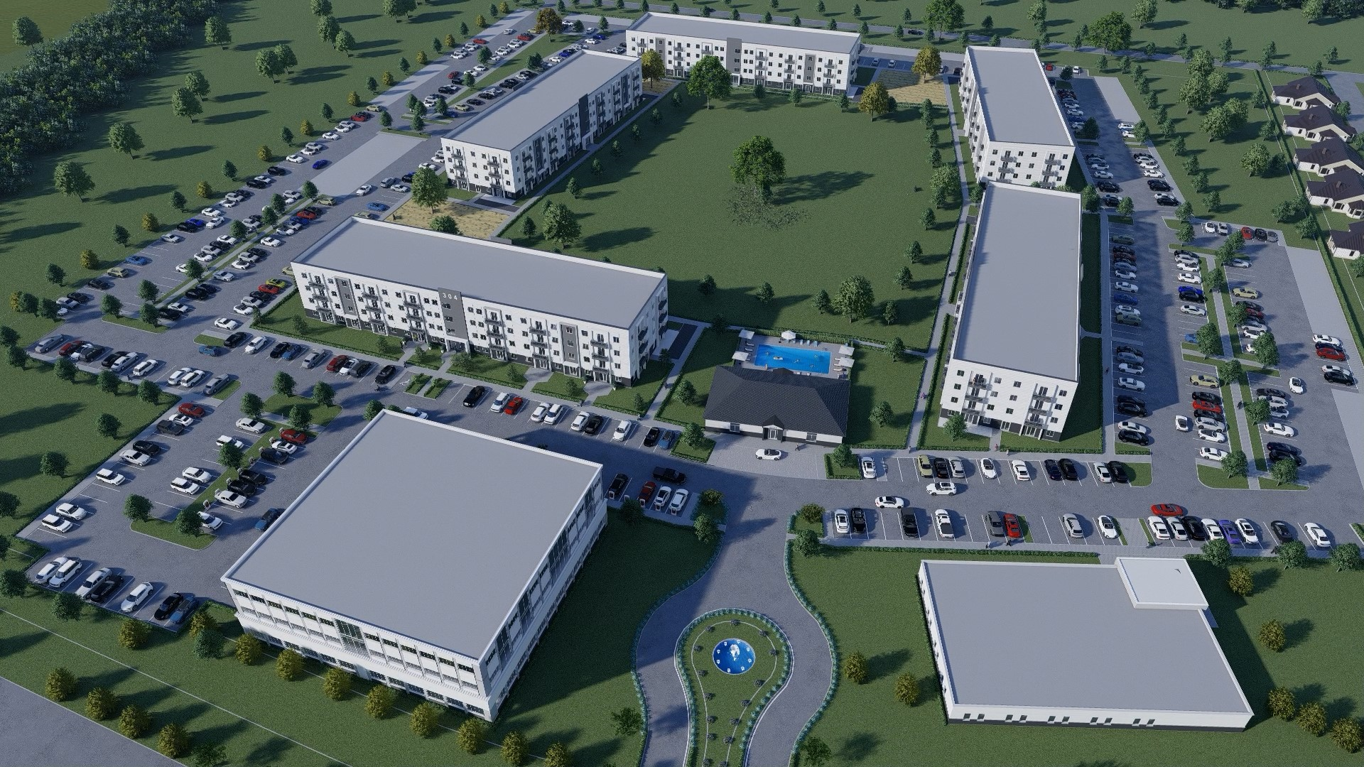
Victory Star Village,
Sioux Falls, South Dakota
300 Multi-family Apartments in
Live-Work-Play Entrepreneurial Campus,
With Corporate Training Center
120,000 sf commercial space – Rent or Condo
  With Smart City Technology Tied to Satellites
  Three Known Anchor Business Renters
  Triple net Leases Signed Before Construction
  Solar Generated Electricity
  Northeast Community College Statutory Partner
  ADA Accessible Aging In Place
  Transit Oriented – Automobile Free Living/Working
Qualified Opportunity Zone Adds 20% After Tax net Profit. Experienced Sponsor Provides HUD Refinanced Exit Strategy.
Land purchased and shovel ready (with experienced builder and partially-entitled)

Slide 4
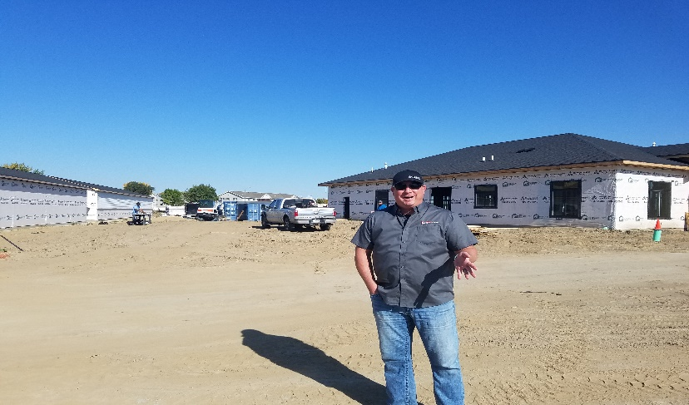
85 Years of Experience Master Developer, Fund Manager, General Contractor
Risk Reduction Blackrock Bond Account and Line of Credit on Stocks
$57 Subsidies, Non-Recourse HUD Refinance,
Four Strong Ways to Get Paid with
12-City Franchise Custom Built Technology System
Corporate, Community College, City, Paying Partnerships
Demand
Technology Services and Information Packages for Sale with Capital Gains
Aging-in-Place,
Healthcare, Small Business Offices
For Housing,
9 9
Tax Free until 2047.
98% Occupancy Across the Street, with Pre-leased Offices
Sale Value
of Shares on
Stock Market Carbon negative Real Estate.
Roy Perry, GC
Built Eleven
Multifamily
Apartment
Complexes
25 Years Experience

Slide 5
Revenue Sources from Mixed Use Real Estate, Technology, Solar, Administrative Fees, and Businesses
Sources
Owner/Investor Equity |  | $7.2M
SEC (NMTC) |  | $5.0M
VSV (QOZB) |  | $2.2M
CRA-eligible construction financing (52.5% LTC) |  | $62.3M
PACE clean energy financing (15% LTC) |  | $24.0M
Tax Increment Financing (TIF) |  | $15.8M
net Value of Tax Credits |  | $6.0M
Renewable energy tax credits (40%) |  | $3.4M
Total Sources |  | $118.6M
Uses
Land Cost |  | $4.6M
Pre_Development |  | $0.1M
Site Infrastructure |  | $1.2M
Architect/Engineer |  | $3.2M
Soft Costs |  | $1.6M
Carrying Costs |  | $3.0M
AdvantEdge Technology License |  | $1.0M
Renewable Energy |  | $8.5M
Apartments, Garages ($17m less Due to CPACE) |  | $63.0M
Clubhouse Training Center |  | $1.5M
Pool |  | $0.2M
Commercial Buildings |  | $7.0M
Contingency |  | $1.0M
Contractor Overhead |  | $8.0M
Contractor Profit |  | $8.0M
Developer Fee |  | $6.7M
Total Uses |  | $118.6M
*Tax increment financing (TIF) is approved, but contingent upon development of single-family housing by a joint-venturer although it is anticipated to be available. In addition, equity from new Market Tax Credits is anticipated.
Status of Equity from Incentives & Tax Credits |  | IRR
Phase I TIF only (as presented above) |  | 36.2%
Revenue – Mixed Use Buldings, Technology, Solar Collection, Administrative Fees
Apartments
Unit | Avg SF | # Units | Rent/SF | Tech/Ent Pkg | Fees | Avg Mo (Value in Millions) | Annual (Value in Millions)
1 BR | 948 | 60 | 1.23 | 90 | $ 377 | $0.076M | $0.9M
Star Entrepreneurial Campus (SEC) |  | 60
Victory Star Village (VSV) |  | 0
2BR | 1264 | 200 | 1.26 | 90 | $ 1,683 | $0.338M | $4.1M
SEC |  | 64
VSV |  | 136
40 3BR and 75 Single Houses | 1486 | 115 | 1.3 | 90 | $ 1,120 | $0.225M | $2.7M
SEC |  | 0
VSV |  | 40
 |  |  |  |  |  |  | $7.7M
Veterans Small Business Center
Corp. Subsidy for Business Rents
Phase I 60,000, Ph.II 40,000 | 100,000 |  | 24 | 250 |  | $2.4M | $2.4M
Training Ctr, PTAC, 62 Amenities
Extra income from "goody bag" options / events / etc.
Est. add 10% |  |  |  |  |  |  | $1.0M
Annual Gross Revenue: VV Project |  |  |  |  |  |  | $11.1M
SEC |  |  |  |  |  |  | $3.6M
VSV |  |  |  |  |  |  | $7.4M
NMTC Breakdown for residential test:
Gross rental income from dwelling units per IRC §168(e)(2)(A) |  |  |  |  |  | $2.1M | 46.2%
Gross rental income not from dwelling units |  |  |  |  |  | $2.4M | 53.8%
*Preliminary-- Subject to Change

Slide 6
4 Project Pillars for Successful Financial Business Model
Tax Benefits
Add 20% After Tax Profit
$58M in Opportunity Zone Tax benefits for capital gains investment.
Services / Revenue Streams
Business 53.8%
Apartments 46.2%
Smart City Tech revenue
Strong Development/Business Team
Leveraged Special Financing
Five Renewable Energy Incentives
$57m in CPACE clean energy and Tax Increment Financing (TIF) Multifamily and
Clean energy revenue
High tech security, health, and software services
Private Program Investment for Family Offices
120,000 SF NNN leasing
P
Proven development team with skills in multifamily apartments, finance, technology, small business and healthcare.
$4m TIF Commercial
Tax Free Cash-Flows
Income: Programs, Amenities
$4.2m Greenhouse Tax Credits
Family Foundation Grants
Exit Strategy by Founder
=
Higher Returns
Over 20% Projected IRR
68% Gross Profit margin
Creates 450 Jobs

Slide 7
Exit Strategy Objectives
Return of Capital, generate attractive risk-adjusted returns with tax credit incentive leverage and achieve above market IRR .
Provide exit strategy through Joint Venture Partner and Sponsor
  HUD Refinance Loan at 3rd or 5th Year
  Use Cost Segregation Studies and reinvest capital gain tax liability at exit.
  Time tax credit revenue for strategic cashflow advantage
Exclude (forgive) capital gains taxes for QOZ Fund operating business and real estate appreciation if held for at least ten years.
Reduce or permanently depreciation recapture taxes
Offer Family Office Program Related Investment Extras

Slide 8
Sources and Uses
Proprietary/Confidential -- Veterans Victory Housing & Small Business Centers (SM)
Sources
Owner/Investor Equity |  | $13.6M
Star Entrepreneurial Campus |  | $5.0M
Victory Star Village (QOZB) |  | $8.6M
Completion Assurance Guarantee Financing |  | $95.8M
PACE clean energy financing |  | $36.9M
Tax Increment Financing (TIF) Limited Tax Revenue Bond |  | $29.0M
net Value of Tax Credits |  | $4.0M
Renewable energy tax credits (40%) |  | $3.2M
Total Sources |  | $182.5M
Uses
Land Cost |  | $4.9M
Pre_Development |  | $0.1M
Site Infrastructure |  | $1.2M
Architect/Engineer |  | $3.5M
Legal, Accounting |  | $0.5M
Carrying Costs |  | $0.0M
AdvantEdge Technology License |  | $1.0M
Renewable Energy and Battery System |  | $8.0M
Apartments,Garages, Single Family Houses |  | $132.7M
Clubhouse and Training Center |  | $1.6M
Building Permit, Other Fees |  | $1.1M
Commercial Buildings |  | $7.0M
Const/Dev Contingency |  | $13.0M
Development Studies |  | $0.8M
Development Salaries |  | $0.4M
Developer Fee |  | $6.7M
Total Uses |  | $182.5M
Sources
Owner/Investor Equity |  | $7.2M
SEC (NMTC) |  | $5.0M
VSV (QOZB) |  | $2.2M
CRA-eligible construction financing (52.5% LTC) |  | $62.3M
PACE clean energy financing (15% LTC) |  | $24.0M
Tax Increment Financing (TIF) |  | $15.8M
net Value of Tax Credits |  | $6.0M
Renewable energy tax credits (40%) |  | $3.4M
Total Sources |  | $118.6M
Uses
Land Cost |  | $4.6M
Pre_Development |  | $0.1M
Site Infrastructure |  | $1.2M
Architect/Engineer |  | $3.2M
Soft Costs |  | $1.6M
Carrying Costs |  | $3.0M
AdvantEdge Technology License |  | $1.0M
Renewable Energy |  | $8.5M
Apartments, Garages ($17m less Due to CPACE) |  | $63.0M
Clubhouse Training Center |  | $1.5M
Pool |  | $0.2M
Commercial Buildings |  | $7.0M
Contingency |  | $1.0M
Contractor Overhead |  | $8.0M
Contractor Profit |  | $8.0M
Developer Fee |  | $6.7M
Total Uses |  | $118.6M
*Tax increment financing (TIF) is approved, but contingent upon development of single-family housing by a joint-venturer although it is anticipated to be available. In addition, equity from new Market Tax Credits is anticipated.
Status of Equity from Incentives & Tax Credits |  | IRR
Phase I TIF only (as presented above) |  | 36.2%

Slide 9
Revenue – Mixed Use Buildings, Technology, Solar Collection, Administrative Fees
Victory Star Village Multifamily-Apartments and Star Entrepreneurial Campus
Lifestyle With Purpose Holistic Campus – Not Including Single Family Houses*
Proprietary/Confidential -- Veterans Victory Housing & Small Business Centers (SM)
Sources
Owner/Investor Equity |  | $7.2M
SEC (NMTC) |  | $5.0M
VSV (QOZB) |  | $2.2M
CRA-eligible construction financing (52.5% LTC) |  | $62.3M
PACE clean energy financing (15% LTC) |  | $24.0M
Tax Increment Financing (TIF) |  | $15.8M
net Value of Tax Credits |  | $6.0M
Renewable energy tax credits (40%) |  | $3.4M
Total Sources |  | $118.6M
Uses
Land Cost |  | $4.6M
Pre_Development |  | $0.1M
Site Infrastructure |  | $1.2M
Architect/Engineer |  | $3.2M
Soft Costs |  | $1.6M
Carrying Costs |  | $3.0M
AdvantEdge Technology License |  | $1.0M
Renewable Energy |  | $8.5M
Apartments, Garages ($17m less Due to CPACE) |  | $63.0M
Clubhouse Training Center |  | $1.5M
Pool |  | $0.2M
Commercial Buildings |  | $7.0M
Contingency |  | $1.0M
Contractor Overhead |  | $8.0M
Contractor Profit |  | $8.0M
Developer Fee |  | $6.7M
Total Uses |  | $118.6M
*Tax increment financing (TIF) is approved, but contingent upon development of single-family housing by a joint-venturer although it is anticipated to be available. In addition, equity from new Market Tax Credits is anticipated.
Status of Equity from Incentives & Tax Credits |  | IRR
Phase I TIF only (as presented above) |  | 36.2%
Phase | January Phase 1 2027 | January Phase II 2028 | January Phase III 2029 | January 2030 | 2031 | 2036
 | Build 120 Apartments | Build 120 Apts | Build 60 Apts and Garages | Income 300 Apartments |  | Value of QOZ Project
 | Buy Renew Energy HVAC |  |  | 46.2% of Total Income |  | Operating Business
 | Arch, Engineer, Legal |  |  | Cash Out Refinance Potential |  | And Real Estate
Costs | Cost $50.2m | Cost $35.6m | Cost $24.3m |  |  | Sale Value $210m
 |  | Income from 120 Apts Begins | Income 240 Apts Available | Income - Business Offices |  | Exit Cap.GainsTaxFree
 |  |  | Income from Training Center | 53.8% of Total Income
 |  |  | JV Investor Proceeds $144m | JV Proceeds $177m
Income |  | $2.9m Income | $10m Income | $13m Annual Income |  | $15m Annual Income
 | CPACE $13m used | CPACE Equity $17m used | CPACE Equity $8.3m used | TIF #1 $15.8m Pays until 15th Yr
 |  | Green Tax Credit $4.2m | $16m GHG Inc with cost Study | TIF #2 $4m Pays until 15th Yr
Subsidies |  | $21.2m Subsidies | $24.3m Subsidies
 |  |  |  |  |  | Franchise Value $10m
Extras | Grant Income $1.5 | Grant Income $1.5m | Grant Income $1.5m
 |  | Initiate #1 HUD Loan Application | Initiate #2 HUD Application*
 |  | Greenhouse Gas Rebate $3.2m
Tax Deductions | $7.3m | $13m | $22.3m | $9.2m | Qualified Opportunity Zone Tax Deductions
Add ons | Congressional Earmark $20m | Potential $20m EPA Grant | Hud Loan 90 days of stabilized income | Capital Account goes to Zero | Deductions | $119,000,000

Slide 10
Financial Ratios for the 10 Year QOZB
 |  |  | COO+1 | COO+2 | COO+3 | COO+4 | COO+5 | COO+6 | COO+7 | COO+8 | COO+9 | COO+10
Yield on Cost |  |  | 1.6% | 4.0% | 6.6% | 7.4% | 7.7% | 8.0% | 8.3% | 8.6% | 8.9% | 9.2%
After-Tax Cash on Cash |  |  | 0.0% | 0.0% | 68.8% | 79.3% | 82.8% | 86.3% | 90.0% | 93.9% | 97.8% | 101.9%
Return on Investment |  |  | -15.1x | -2.2x | 13.3x | 18.2x | 20.0x | 21.9x | 23.8x | 25.9x | 28.0x | 30.2x
IRR |  |  |  |  |  |  |  |  |  |  |  |  | 44.9%
Debt to Equity Ratio |  |  | (0.64) | (0.09) | 0.50 | 0.71 | 0.80 | 0.89 | 0.99 | 1.10 | 1.21 | 1.34
 |  |  |  |  | *Debt Finance Distributions after two years.
 |  |  |  |  | **Management drives Capital Account to an negative position to take advantage of Qualified Opportunity Zone Benefits
 |  |  |  |  | ***This is not a Prospectus or Offer
After-Tax Cash Flows |  | $0.0M | $0.0M | $0.0M | $0.8M | $1.8M | $2.2M | $2.5M | $2.8M | $3.2M | $3.6M | $4.0M | $20.9M | After Tax Cash Flows
Depreciation & Amortization
Straight-Line Depreciation |  |  | $0.8M | $1.6M | $2.5M | $2.5M | $2.5M | $2.5M | $2.5M | $2.5M | $2.5M | $2.5M
Bonus Depreciation |  |  | $5.1M | $4.9M | $4.9M
Start-Up Cost Amortization |  |  | $0.8M | $0.8M | $0.8M | $0.8M | $0.8M | $0.8M | $0.8M | $0.8M | $0.8M | $0.8M
Passive Loss Carryforward |  |  | $0.0M | $6.8M | $11.3M | $9.8M | $7.9M | $5.6M | $2.9M | -$0.2M | -$3.8M | -$7.8M
Section 45L Tax Credit Carryforward |  |  | $0.6M | $0.6M | $0.6M | $0.6M | $0.6M | $0.6M | $0.6M | $0.6M | $0.6M | $0.6M
Adjusted IRR With QOF Deferral
Estimated Value at end of 10 years at 6.0% cap rate ** |  |  |  |  |  |  |  |  |  |  |  |  | $186.5M
Value of Equity at end of 10 years *** |  |  |  |  |  |  |  |  |  |  |  |  | $147M
Estimated Value with TIF Projections |  |  |  |  |  |  |  |  |  |  |  |  | 210.0M
Value of Equity at end of 10 years with TIF*** |  |  |  |  |  |  |  |  |  |  |  |  | 164.7M
Total Investment |  | $7.2M
Value of QOF deferral + |  | -$0.1M
Effective Investment |  | $7.1M
IRR With QOF Value++ |  | -$7.1M | $0.0M | $0.0M | $0.8M | $1.8M | $2.2M | $2.5M | $2.8M | $3.2M | $3.6M | $4.0M | $147M | 16.8%
10-Year Cash on Cash Ratio+++ |  | 291%

Slide 11
Waterfall
 |  |  |  |  | COO+1 | COO+2 | COO+3 | COO+4 | COO+5 | COO+6 | COO+7 | COO+8 | COO+9 | COO+10
Operating Profit |  |  |  |  | $ 2,854,395 | $ 7,080,605 | $ 11,584,311 | $ 13,026,829 | $ 13,500,536 | $ 13,991,178 | $ 14,499,355 | $ 15,025,687 | $ 15,570,819 | $ 16,135,415
 | Cap Rate |  |  |  | 6.0% | 6.0% | 6.0% | 6.0% | 6.0% | 6.0% | 6.0% | 6.0% | 6.0% | 6.0%
Enterprise Value |  |  |  |  | $ 47,573,244 | $ 118,010,086 | $ 193,071,845 | $ 217,113,821 | $ 225,008,934 | $ 233,186,299 | $ 241,655,913 | $ 250,428,125 | $ 259,513,650 | $ 268,923,578
Less Debt |  |  |  |  | $ 131,368,083 | $ 129,988,406 | $ 128,512,152 | $ 126,932,561 | $ 125,242,398 | $ 123,433,923 | $ 121,498,855 | $ 119,428,333 | $ 117,212,874 | $ 114,842,333
Total Equity |  |  |  |  | $ (83,794,839) | $ (11,978,320) | $ 64,559,693 | $ 90,181,260 | $ 99,766,536 | $ 109,752,376 | $ 120,157,057 | $ 130,999,792 | $ 142,300,776 | $ 154,081,246
Ownership
 | Developer |  |  |  | 5.0% | 5.0% | 5.0% | 5.0% | 5.0% | 5.0% | 5.0% | 5.0% | 5.0% | 5.0%
 | Sponsors |  |  |  | 5.0% | 5.0% | 5.0% | 5.0% | 5.0% | 5.0% | 5.0% | 5.0% | 5.0% | 5.0%
 | Investors |  |  |  | 90.0% | 90.0% | 90.0% | 90.0% | 90.0% | 90.0% | 90.0% | 90.0% | 90.0% | 90.0%
Equity Allocation
 | Developer |  |  |  | $ (4,189,742) | $ (598,916) | $ 3,227,985 | $ 4,509,063 | $ 4,988,327 | $ 5,487,619 | $ 6,007,853 | $ 6,549,990 | $ 7,115,039 | $ 7,704,062
 | Sponsors |  |  |  | $ (4,189,742) | $ (598,916) | $ 3,227,985 | $ 4,509,063 | $ 4,988,327 | $ 5,487,619 | $ 6,007,853 | $ 6,549,990 | $ 7,115,039 | $ 7,704,062
 | Investors |  |  |  | $ (75,415,355) | $ (10,780,488) | $ 58,103,723 | $ 81,163,134 | $ 89,789,883 | $ 98,777,138 | $ 108,141,352 | $ 117,899,813 | $ 128,070,698 | $ 138,673,121
Total Equity Allocation |  |  |  |  | $ (83,794,839) | $ (11,978,320) | $ 64,559,693 | $ 90,181,260 | $ 99,766,536 | $ 109,752,376 | $ 120,157,057 | $ 130,999,792 | $ 142,300,776 | $ 154,081,246
Total Distributions |  |  |  |  | $ - | $ - | $ 9,372,038 | $ 10,800,952 | $ 11,270,063 | $ 11,755,948 | $ 12,259,201 | $ 12,780,437 | $ 13,320,293 | $ 13,879,428
 | 8% Base Return |  |  |  | $ 400,000 | $ 400,000 | $ 400,000 | $ 400,000 | $ 400,000 | $ 400,000 | $ 400,000 | $ 400,000 | $ 400,000 | $ 400,000
 | Preferred Return (30% of cash flow above Base Return) |  |  |  | $ - | $ - | $ - | $ - | $ - | $ - | $ - | $ - | $ - | $ -
 | Total to Sponsors |  |  |  | $ - | $ - | $ 937,204 | $ 1,080,095 | $ 1,127,006 | $ 1,175,595 | $ 1,225,920 | $ 1,278,044 | $ 1,332,029 | $ 1,387,943
 | Total to Investors |  |  |  | $ - | $ - | $ 8,434,834 | $ 9,720,857 | $ 10,143,057 | $ 10,580,353 | $ 11,033,281 | $ 11,502,393 | $ 11,988,264 | $ 12,491,485
Investor Returns
 | Capital Account Reduction |  |  |  | $ 5,000,000
 | Distributions |  |  |  | $ - | $ - | $ 8,434,834 | $ 9,720,857 | $ 10,143,057 | $ 10,580,353 | $ 11,033,281 | $ 11,502,393 | $ 11,988,264 | $ 12,491,485
 | Equity Allocation |  |  |  | $ (75,415,355) | $ (10,780,488) | $ 58,103,723 | $ 81,163,134 | $ 89,789,883 | $ 98,777,138 | $ 108,141,352 | $ 117,899,813 | $ 128,070,698 | $ 138,673,121
net Investor Return |  |  |  |  | $ (80,415,355) | $ (15,780,488) | $ 61,538,557 | $ 85,883,991 | $ 94,932,940 | $ 104,357,492 | $ 114,174,633 | $ 124,402,206 | $ 135,058,962 | $ 146,164,606
 | Return on Investment |  |  |  | -15.1 | -2.2 | 13.3 | 18.2 | 20.0 | 21.9 | 23.8 | 25.9 | 28.0 | 30.2
 | IRR |  |  |  |  |  |  |  |  |  |  |  |  | 44.9%
Developer
 | Management Fee |  |  |  | $ 35,458 | $ 74,950 | $ 117,027 | $ 130,631 | $ 135,226 | $ 139,983 | $ 144,907 | $ 150,004 | $ 155,279 | $ 160,740
 | Distributions |  |  |  | $ - | $ - | $ 468,602 | $ 540,048 | $ 563,503 | $ 587,797 | $ 612,960 | $ 639,022 | $ 666,015 | $ 693,971
 | Equity Allocation |  |  |  | $ (4,189,742) | $ (598,916) | $ 3,227,985 | $ 4,509,063 | $ 4,988,327 | $ 5,487,619 | $ 6,007,853 | $ 6,549,990 | $ 7,115,039 | $ 7,704,062
Sponsors
 | Distributions |  |  |  | $ - | $ - | $ 468,602 | $ 540,048 | $ 563,503 | $ 587,797 | $ 612,960 | $ 639,022 | $ 666,015 | $ 693,971
 | Equity Allocation |  |  |  | $ (4,189,742) | $ (598,916) | $ 3,227,985 | $ 4,509,063 | $ 4,988,327 | $ 5,487,619 | $ 6,007,853 | $ 6,549,990 | $ 7,115,039 | $ 7,704,062
IRR |  | -13272800 |  |  | $ - | $ - | $ 8,434,834 | $ 9,720,857 | $ 10,143,057 | $ 10,580,353 | $ 11,033,281 | $ 11,502,393 | $ 11,988,264 | $ 151,164,606 | 44.9%
This is not a prospectus or offer.
After-Tax Cash Flows |  | $0.0M | $0.0M | $0.0M | $0.8M | $1.8M | $2.2M | $2.5M | $2.8M | $3.2M | $3.6M | $4.0M | $20.9M | After Tax Cash Flows
Depreciation & Amortization
Straight-Line Depreciation |  |  | $0.8M | $1.6M | $2.5M | $2.5M | $2.5M | $2.5M | $2.5M | $2.5M | $2.5M | $2.5M
Bonus Depreciation |  |  | $5.1M | $4.9M | $4.9M
Start-Up Cost Amortization |  |  | $0.8M | $0.8M | $0.8M | $0.8M | $0.8M | $0.8M | $0.8M | $0.8M | $0.8M | $0.8M
Passive Loss Carryforward |  |  | $0.0M | $6.8M | $11.3M | $9.8M | $7.9M | $5.6M | $2.9M | -$0.2M | -$3.8M | -$7.8M
Section 45L Tax Credit Carryforward |  |  | $0.6M | $0.6M | $0.6M | $0.6M | $0.6M | $0.6M | $0.6M | $0.6M | $0.6M | $0.6M
Adjusted IRR With QOF Deferral
Estimated Value at end of 10 years at 6.0% cap rate ** |  |  |  |  |  |  |  |  |  |  |  |  | $186.5M
Value of Equity at end of 10 years *** |  |  |  |  |  |  |  |  |  |  |  |  | $147M
Estimated Value with TIF Projections |  |  |  |  |  |  |  |  |  |  |  |  | 210.0M
Value of Equity at end of 10 years with TIF*** |  |  |  |  |  |  |  |  |  |  |  |  | 164.7M
Total Investment |  | $7.2M
Value of QOF deferral + |  | -$0.1M
Effective Investment |  | $7.1M
IRR With QOF Value++ |  | -$7.1M | $0.0M | $0.0M | $0.8M | $1.8M | $2.2M | $2.5M | $2.8M | $3.2M | $3.6M | $4.0M | $147M | 16.8%
10-Year Cash on Cash Ratio+++ |  | 291%

Slide 12
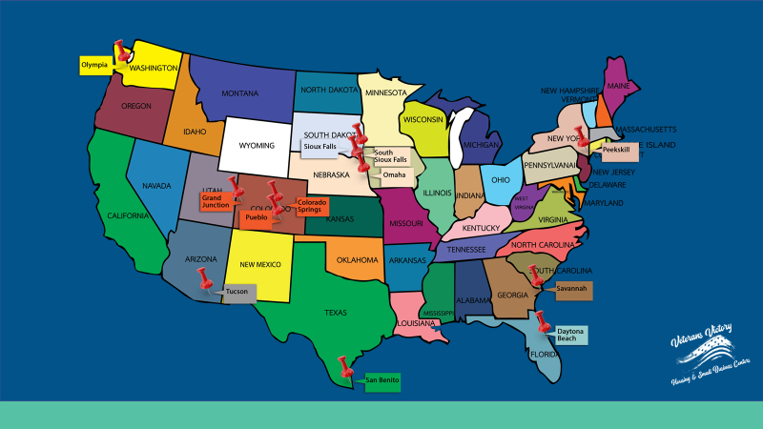
Current and Future Projects
Existing Projects
Sioux Falls
Colorado Springs
South Sioux City
Future Projects
Daytona Beach, FL
San Benito, TX
Tucson, AZ
Omaha, NE
Olympia, WA
Savannah, GA
Clarksville, TN
San Diego, CA
Omaha, ne
Peekskill, NY
Tulsa, OK

Slide 13
DEVELOPER/CONSTRUCTION/MANAGEMENT TEAM
Victory Entrepreneurial Small Business Campuses, Kim Kuhle, Founder
R. Perry Construction, Commercial Contractors, Construction Manager, Developer of 11 Multifamily Complexes, Roy Perry, President
Paul Martin, Plan Architecture, Matthew Smith, Olsson Engineering
Matt Dow, VS VVSBC, Ret. U.S. Marine
LEGAL/TAX/FINANCE TEAM
Mary E. Vandenack, J.D., ACTEC, CAP®, COLPM®, Duggan Bertsch, Michael J. Weaver, J.D., CPA, James S. Pieper, J.D., PhD (Consultant)
TECHNOLOGY/GREEN EneRGY/BUSIneSS DEVELOPMENT PROGRAMS
ThinkBox, Daron Coates and Paul Orentas, Co-Founders and Managing Directors
GTSG Global - AdvantEdge Technology (Internet of Things “IoT”) - Mike Wofford, CEO
Van Horn Ventures LLC, Business Development
This is not a prospectus or an offer.

