Slide 1
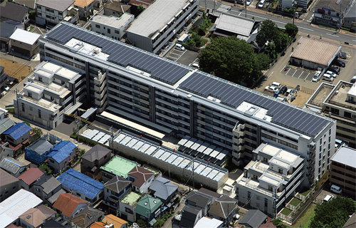
Solar Energy
Solar panels
7 buildings
14K sq ft/building
4-story buildings
500KW system
Tax credit
22%
22%
10%
10%
State-of-the-art technology
Collaboration with Colorado Springs Utility

Slide 2
Solar Lighting (parking lot)
Highly visible green community
Energy efficiency
Self-funding
Potential revenue generator
Constructed as part of the community
Connected to the local electric grid

Slide 3
Smart Meters
Real-time reading of usage from individual units
Allows for remote monitoring
Connected to electric billing system provided by Colorado Springs
Integrated with solar generation and give-backs

Slide 4
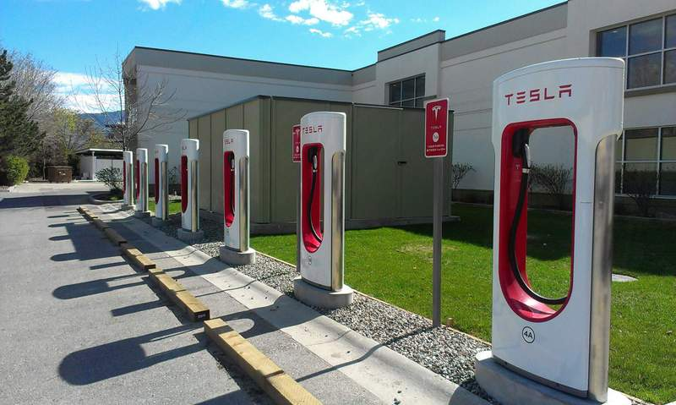
Electric Charging Stations
Use for residents and visitors
Level 2 chargers
Planned as part of a network (e.g. PlugShare, Open Charge, ChargeHUB)
Pay-by-app
Foundation for clean energy

Slide 5
High Tech Apartments
High-speed broadband internet service
Pre-occupancy wired (CAT5/6)
Secured private network (Proprietary software)
Energy management apps
Optional security to units
Digital connection to other Veterans Villas

Slide 6
AdvantEdge - A UNIQUE NEW COMPANY
Newly formed company, based in Omaha, NE
Created to own, enhance, and commercialize
complementary patented products
Internet and texting technologies operational
20+ patients acquired
Managed by a group of highly experienced management
Smart Cities Technolgies, IoT and Internet Middleware for Faster and More Secured Connectivity

Slide 7
Veterans Villa IoT
Veteran’s Services
Healthcare
Training
eCommerce
Job Placement
Start-Up
Banking
Internet
Business Intelligence
Solar Grid
Data
Distributed Internet System (DIS)
Panels
DIS
Analytics
Batteries
Enterprise Tier
Web services
Deployment Tier
Reporting
Controller
Key Performance
Voltage Regulators
Internet
Real Estate Management
DIS
Building Services
“AdvantEdge Campus”
Power Management
Client Tier
Web services
Sensors
Water/Sewer Usage
IoT Tier
Meters
Charging Stations
Internet of Things (IoT)
Building Security
Open Architecture Secured Connectivity API
WiFi Boosters
Other sensors
Lot Lighting
Unit Security
AI Software
Lot
Camera
Security End Points

Slide 8
WHAT IS DIS MIDDLEWARE?
A Distributed Asset Management System:
Secures the handling of content, data, and executable assets
Proprietary Virtual Private Network (VPN) uses Internet as the backbone
Users subscribe for access to DIS and the DIS server authorizes and controls that access
Addresses Internet interruptions by intelligent deployment of assets to Edge servers and hierarchical store/forward between intelligent nodes
Increases up-time through asset peering using deployment of redundant
server nodes to the edge of the Internet in the form of Edge Servers
Single point of control to define and manage the VPN
Can break-down and encapsulate existing software without the need to modify current code
Powerful integration platform capable of accommodating legacy software and integration of new development
Addresses Extended Geographical Areas – Works In Strong To Relatively Fragile Internet Infrastructures

Slide 9
THE BENEFITS OF DIS MIDDLEWARE
DIS Middleware Solves Many Challenges:
High service level is guaranteed
Full application integrity and instant availability
Full Scalability – distribution among active elements over
the Network
Service levels independent of Internet/Web characteristics
Any type of device is served
Hardware compatibility and data connectivity addressed
Security level vastly improved

Slide 10
WHAT IS e-TXT?
Digital Commerce solution (e-TXT) that enables real-time donations or purchases made by text (SMS):
Cellular –agnostic to the cell carrier, no special app on the phone, integrated with Social Media
Payment Clearing – 48-hour receipt to deposit, 4 major payment processors and Secure/PCI Compliant payment gateway.
Cloud Storage –Amazon Cloud containing user, client and proprietary engine
Client Data and Data Analytics –client portal which includes relationship management, reporting, analytics and administration.

Slide 11
End-to-End Security
Initial Enrollment
Secured database of user profile (AWS)
Proprietary middleware (DIS) securing initial user configuration
Two-factor authentication
Donor Validation
Password exchange to initialize donation
Dedicated key word for specific donation campaign
Amount verification
Merchant Processing (Veterans Owned Business)
PCI compliant gateway
Dedicated merchant account owed by AdvantEdge
Additional third-party processors
Reconciliation/Verification
User notification and alerts
Campaign analytics

Slide 12
Investment Opportunity
Investors keep tax deductions from rental income and capital gains deductions on insured property
Investors can enter and leave during any year
Investors pays original capital gains tax in 7 years, minus 10% reduction in basis
Capital gain tax elimination after 10 years
Accelerated depreciation
Opportunity Zone Funds pays quarterly dividends
*This is not an offer of investment.

