Slide 1

Veterans Victory Housing and Small Business Centers
Victory Star Village
Mixed Use Development
Sioux Falls, South Dakota
Internal Development Strategy
November 2025

Slide 2
Why Sioux Falls
Population growing ~2.7% annually
Vacancy stabilized at 5.4%
Strong demand for mid-market and veteran housing
No veteran-focused mixed-use community exists today

Slide 3
Sioux Falls Rental Market Overview
Population ~219,500 (2024), +2.7% annually
~1,670 households added/year (50% rental)
Vacancy mid-2025: 5.43%
Average rents: 1-BR $1,000 | 2-BR $1,220
Healthy, growing rental market

Slide 4
Recent Market Trends
Vacancy Jan 2025: ~10.1%; Jul 2025: ~5.4%
→ Rapid absorption and stabilization
Drivers: In-migration, strong jobs, moderating new permits

Slide 5
Supply Snapshot
Market-rate units: ~17,000
Under construction (Apr 2025): ~2,180 units
2024 deliveries: 1,256 units (↓35% Year on year)
Pipeline tapering = reduced future supply risk

Slide 6
Rent and Affordability
Affordable/Workforce: $800–$1,100
Mid-Market: $1,100–$1,450
Luxury: $1,500+
Limited affordable/mid-market supply
Luxury overrepresented downtown

Slide 7
Identified Market Needs
Strong demand for affordable & workforce units
Veteran & workforce housing shortage
Oversupply risk in luxury
Reposition sites to serve workforce & veteran renters

Slide 8
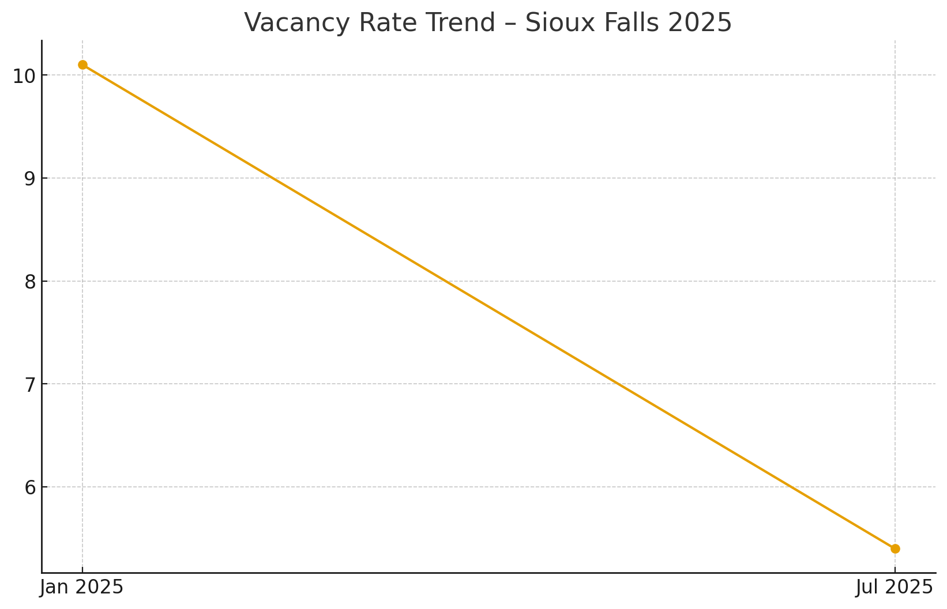
Vacancy Percentage Trend – Sioux Falls 2025

Slide 9
Unit Demand Forecast
Affordable: 1,350–1,500 units
Mid-Market: 2,250–2,500 units
Luxury: 900–1,000 units
≈4,500–5,000 total units needed by 2030

Slide 10
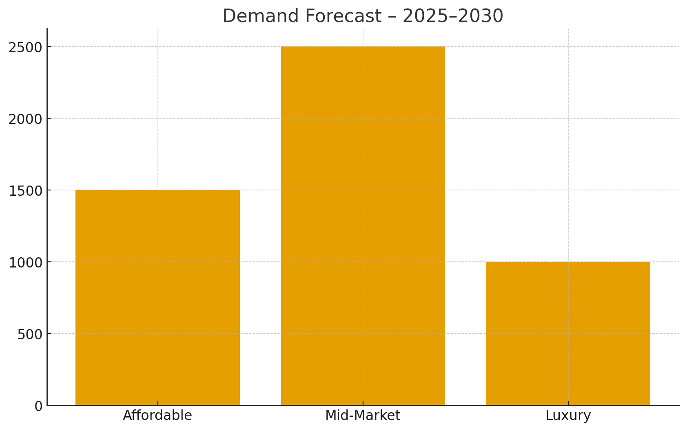
Unit Demand Forecast 2025–2030

Slide 11
Competitive Gap in Sioux Falls
Market saturated with luxury units
Mid-market + veteran-focused segment completely unserved
Opportunity to differentiate through community + mission
Mixed-use lifestyle campus stands apart from competitors

Slide 12
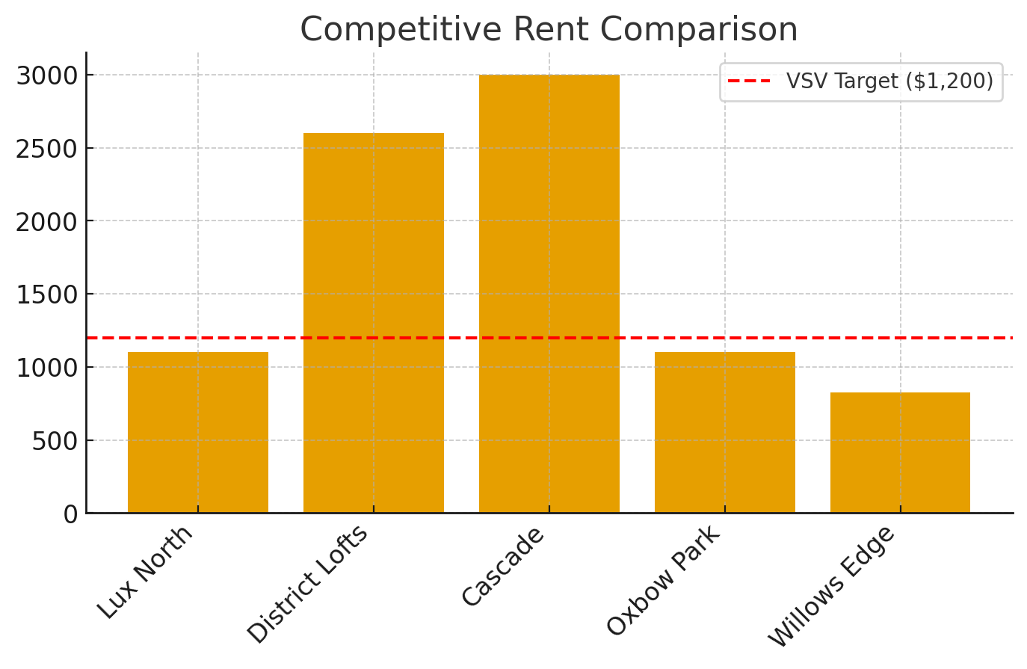
Competitive Rent Positioning

Slide 13
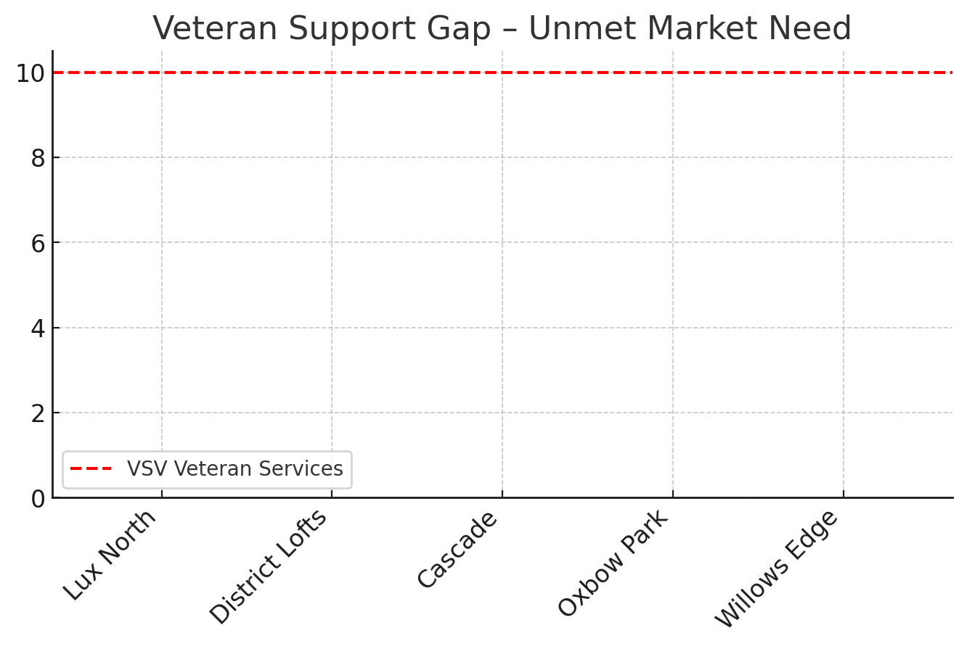
Veteran Service Gap – Market Unmet Need

Slide 14
Veteran-Focused Opportunity
Sioux Falls veterans: ~9,380
~19% face housing cost burdens
Local veteran projects (VCP) show momentum
No market-rate veteran-specific community → Opportunity!

Slide 15
Victory Star Village Concept
120-unit mid-market apartment community
Veteran business center & co-working hub
Community retail pavilion
Mission-driven amenities and programming
Located in federally designated Opportunity Zone

Slide 16
Concept Components
Residential:
80–120 units, rents $950–$1,350
State of the art technology along with Green design focus
Business & Retail:
8–10k sq ft co-working + veteran retail
Partners: VA, nonprofits, incubators

Slide 17
Community Impact
Supports workforce housing goals
Promotes veteran entrepreneurship
Aligns with city growth goals
Activates neighborhood via retail/events

Slide 18
Competitive Positioning
Only veteran-focused mixed-use in region
Mid-market attainable rents
Strong veteran partnerships
Synergy: housing + business + community

Slide 19
Risk & Mitigation
Market saturation → Target mid-market rents
Absorption timing → Phase delivery
Cost inflation → Value engineering
Retail risk → Veteran micro-retail partners

Slide 20
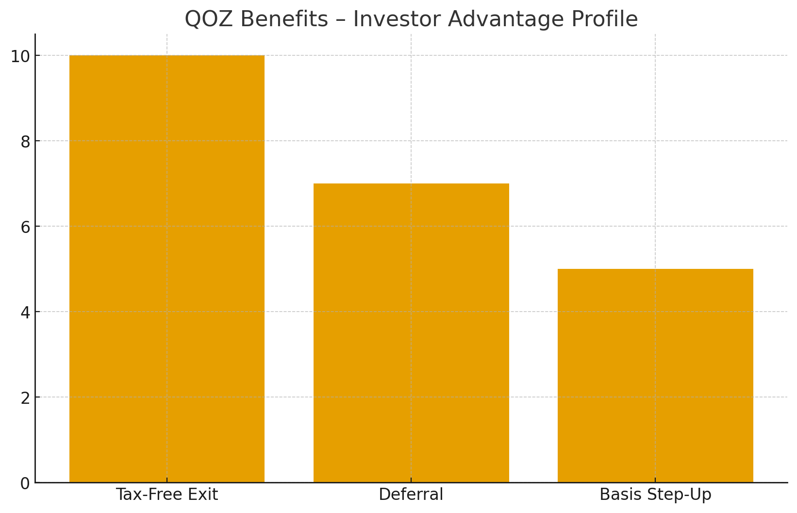
Qualified Opportunity Zone Benefits

Slide 21
Investor Summary
Investment Type: Qualified Opportunity Zone (QOZB)
Asset: Mid-Market Multifamily + Veteran Business Center + Retail
Target IRR: 14–18% depending on scenario
Exit Strategy: HUD Refinance & QOF Tax-Free Exit at Year 10
Minimum Hold: 10 Years (QOZ)
Competitive Edge: No comparable veteran-focused asset in market

